Slide 1

Frontend JavaScript
Introduction to JavaScript
www.pragmatic.bg
Lector: Stiliyan Ivanov
Skype: stiliyan.iv.ivanov
E-mail: stiliyan.ivanov [at] pragmatic.bg
Facebook: https://www.facebook.com/stiliyan.iv.ivanov
LinkedIn: https://www.linkedin.com/in/stiliyan-iv-ivanov/
Copyright © Pragmatic LLC 2013 – 2019

Slide 2
Table of Contents
Dynamic HTML
Compilers, Interpreters, VMs
JavaScript Syntax
Mixing HTML and JavaScript
Data Types
Variables and Scope
Using the Console

Slide 3
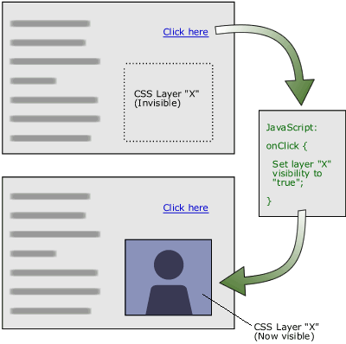
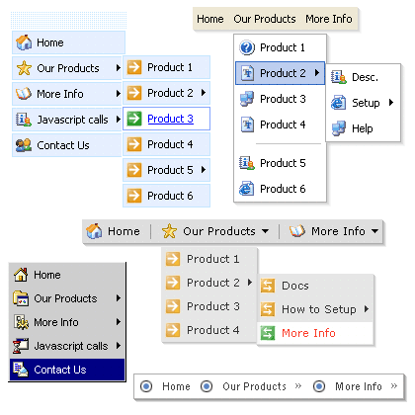
Dynamic HTML Dynamic Behavior at the Client Side

Slide 4
What is DHTML?
Dynamic HTML (DHTML)
Makes possible a Web page to react and change in response to the user’s actions
DHTML consists of HTML + CSS + JavaScript
DHTML
HTML
CSS
JavaScript
DOM

Slide 5
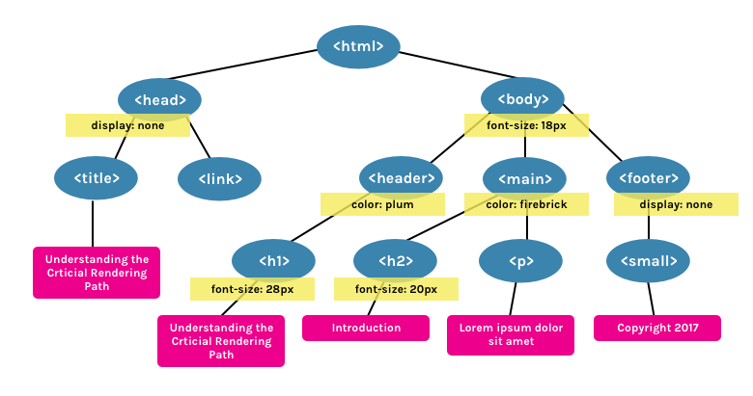
DOM

Slide 6
DTHML = HTML + CSS + JavaScript
HTML defines Web sites content through semantic tags (headings, paragraphs, lists, …)
CSS defines 'rules' or 'styles' for presenting every aspect of an HTML document
Font (family, size, color, weight, etc.)
Background (color, image, position, repeat)
Position and layout (of any object on the page)
JavaScript defines dynamic behavior
Programming logic for interaction with the user, to handle events, etc.

Slide 7

JavaScript Dynamic Behavior in a Web Page

Slide 8
JavaScript
JavaScript is a front-end scripting language developed by Netscape for dynamic content
Lightweight and powerful
Can be used as object-oriented language
Embedded in your HTML page
Interpreted by the Web browser
Client-side, mobile and desktop technology
Simple and flexible
Powerful to manipulate the DOM
Nowadays used also as backend language – Node.js

Slide 9
What Can JavaScript Do?
JavaScript allows interactivity such as:
Implementing form validation
React to user actions, e.g. handle keys
Changing an image on moving mouse over it
Sections of a page appearing and disappearing
Content loading and changing dynamically
Performing complex calculations
Custom HTML controls, e.g. scrollable table
Implementing AJAX functionality

Slide 10

What Can JavaScript Do? (2)
Can read and write HTML elements and modify the DOM tree
Can access / modify browser cookies
Can detect the user’s browser and OS
Can handle exceptions

Slide 11
Static vs. Dynamic Languages
C++ / C# / Java vs. JS / PHP / Python

Slide 12
Static vs. Dynamic Languages
Static Languages
Explicit type declaration
Strongly/Weakly typed
Type checking occurs at compile-time
Statically-typed languages: C, C++, C#, Java
Dynamic Languages
Implicit type declaration
Strongly/Weakly typed
Type checking occurs at run-time
Dynamic languages: JavaScript, PHP, Python, Ruby
string name = "Ivan";
int age = 25;
let name = "Pesho";
let age = 25;

Slide 13
Compilers
Originally a compiler converts a high level language code (like C/C++) into machine code
Machine code is executed by the CPU or VM
Most errors are found at compile time, before execution
C and C++ use compilers to produce native code for the CPU
C# and Java use compilers to produce intermediate code for VM

Slide 14
Interpreters
An interpreter executes a script code line by line
Code is analyzed at run-time (no compilation)
Errors are found at run-time, during the code execution
JavaScript, Python, Ruby and PHP use interpreters
JIT (just-in time compilers) compile to native code at runtime
JIT occurs during the execution, on demand
Available for Java, JavaScript and other languages

Slide 15
Virtual Machines (VM)
Virtual machine (VM) is
A virtual computer (computer inside the computer)
Runs an intermediate code for a virtual CPU
VM-based languages:
JVM (Java Virtual Machine) for Java
CLR (Common language Runtime) for C# / .NET
HHVM for PHP
V8 JavaScript

Slide 16
Compiler vs. Interpreter vs. Virtual Machine
Compiled languages are faster than interpreted languages
C, C++, Rust, Go and Swift are very fast
Compiled to native code for CPU
C# and Java are slower
Compiled to intermediate code for VM
JS, Python, Ruby, PHP are even slower
Interpreted / JIT-compiled

Slide 17
JavaScript Syntax
let a = 'JS FrontEnd';

Slide 18
JavaScript Syntax
The JavaScript syntax is similar to C/C++C#, Java and PHP
Operators (+, *, =, !=, &&, ++, …)
Variables
Conditional statements (if, else)
Loops (for, while)
Functions (with parameters and return value)
Arrays (arr[5]) and associative arrays (arr['maria'])
Objects and classes

Slide 19
JavaScript Code – Example
JS variables, operators, expressions, statements
let a = 7;
let b = 12;
let c = 15;
let sum = a + b + c;
console.log(sum);

Slide 20



Style Guide and Linters
Airbnb JavaScript Style Guide()
ESLint
JSHint

Slide 21
Mix HTML and JavaScript
Using JS Code from HTML Page

Slide 22
Mixing HTML + JavaScript
<!DOCTYPE html>
<html>
<body>
<h1>JavaScript in the HTML page</h1>
<script>
for (let i = 0; i < 10; ++i) {
document.write(`<p>${i}</p>`);
}
</script>
</body>
</html>

Slide 23
Sum Numbers with HTML Form
<form>
num1: <input type="text" name="num1" /> <br>
num2: <input type="text" name="num2" /> <br>
sum: <input type="text" name="sum" /> <br>
<input type="button" value="Sum" onclick="calcSum()" />
</form>
function calcSum() {
let num1 = document.getElementsByName('num1')[0].value;
let num2 = document.getElementsByName('num2')[0].value;
let sum = Number(num1) + Number(num2);
document.getElementsByName('sum')[0].value = sum;
}

Slide 24
Load JavaScript File from HTML Document
random-nums.html
numbers.js
<!DOCTYPE html>
<html>
<head>
<script src="numbers.js">
</script>
</head>
<body>
<input type="submit"
onclick="printRandNum()" />
</body>
</html>
function printRandNum() {
let num = Math.round(
Math.random() * 100);
document.body.innerHTML +=
`<div>${num}</div>`;
}

Slide 25
Data Types in JS
Numbers, Strings, Booleans, Objects

Slide 26
Numbers in JavaScript
All numbers in JS are floating-point (64-bit double-precision)
let n = 7;
console.log(typeof(n) + ' ' + n); // number 7
let bin = 0b10000001;
console.log(typeof(bin) + ' ' + bin); // number 129
let x = Number.parseInt("2.99");
console.log(typeof(x) + ' ' + x); // number 2
let y = Number("2.99");
console.log(typeof(y) + ' ' + y); // number 2.99

Slide 27
Numbers in JavaScript are Floating-Point
let a = 3, b = 4 / a;
console.log(`a=${a} b=${b}`); // a=3 b=1.3333333333333333
console.log(a / 0); // Infinity
console.log(a * Infinity); // Infinity
console.log(0 / 0); // NaN
let bigNum = 10000000000000000;
console.log(bigNum + 1); // 10000000000000000
let num = 0.01, sum = 0;
for (let i=0; i<100; i++)
sum += num;
console.log(sum); // 1.0000000000000007

Slide 28
Strings in JavaScript
Strings in JS are immutable sequences of Unicode characters
let ch = 'x';
console.log(typeof(ch) + ' ' + ch); // string x
let str = "hello";
console.log(typeof(str) + ' ' + str); // string hello
console.log(str.length); // 5
console.log(str[0]); // h
str[0] = 's'; // Beware: no error, but str stays unchanged!
console.log(str); // hello
console.log(str[10]); // undefined

Slide 29
Objects in JavaScript
JS objects hold key-value pairs
let point = {x: 5, y: -2};
console.log(point); // Object {x: 5, y: -2}
console.log(typeof(point)); // object
let rect = {name:"my room", width: 4.5, height: 3.5};
rect.name = "old room";
rect.color = "red";
console.log(rect); // Object {name: "old room", width: 4.5, height: 3.5, color: "red"}
rect = undefined; // "rect" now has no value
console.log(rect); // undefined

Slide 30
Automatic Type Conversion
JS converts between types automatically
let ch = 'x'; // string
console.log(typeof(ch));
ch++; // ch is now number
console.log(typeof(ch));
console.log(ch); // NaN
let num = 0xFF; // 255
console.log(typeof(num));
num = num + "x"; // string
console.log(typeof(num));
console.log(num); // 255x
let n = "1" * 1; // number
let b = Boolean(n);
console.log(typeof(b));
console.log(b); // true
let n = [1]; // array
console.log(typeof(n));
n++; // n is now 2 (number)
console.log(typeof(n));

Slide 31
Variables and Scope
let vs. var

Slide 32
Assigning Variables
Variables in JS have no type, values have type
let x = 5; console.log(typeof(x)); // x is number
x = 'str'; console.log(typeof(x)); // x is now string
x = {x:5, y:7}; console.log(typeof(x)); // x is now object
let n = 5, str = "hello"; // Assigning variables
// Group declaration + assignment (destructuring)
let [name, x, y] = ["point", 5, 7];
console.log(`${name}(${x}, ${y})`); // point(5, 7)

Slide 33
Undefined Variables
JS cannot access undefined variables
Once defined, variables cannot be deleted!
console.log(x);
// Uncaught ReferenceError: x is not defined(…)
let x = 5;
x = undefined;
console.log(x); // undefined
// The variable x exists, but has no value defined

Slide 34
Variable Scope: let vs. var
let has "block scope"
var has "function scope"
for (let x=1; x<=5; x++)
console.log(x); // 1 … 5
console.log(x); // Ref. error
for (var x=1; x<=5; x++)
console.log(x); // 1 … 5
console.log(x); // 6
function test() {
console.log(x); // Ref. error
let x = 5;
}
test();
function test() {
console.log(x); // undefined
var x = 5;
}
test();

Slide 35
Variable Scope: let vs. var (2)
let has "block scope"
var has "function scope"
let x = 100; // block scope
console.log(x); // 100
for (let x=1; x<=5; x++) {
console.log(x); // 1 … 5
} // end of block scope
console.log(x); // 100
var x = 100; // function scope
console.log(x); // 100
for (var x=1; x<=5; x++) {
console.log(x); // 1 … 5
} // same x inside the loop
console.log(x); // 6
console.log(x); // Ref.error
let x;
console.log(x); // undefined
var x;

Slide 36
Global Variables
In the Web browser
Server side (in Node.js)
x = 5;
console.log(x); // 5
console.log(window.x); // 5
x = 5;
console.log(x); // 5
console.log(global.x); // 5
Strict mode forbids using undefined global variables
'use strict';
x = 10; // Reference error
window.x = 5;
console.log(x);
'use strict';
window.x = 5;
x = 10; // This will work
console.log(x); // 10

Slide 37
Constant Declarations
JS supports constants – declared by the const keyword
Once assigned, constants cannot be modified
const path = '/images';
console.log(`${path}/logo.png`);
// Logo path: /images/logo.png
path = '/img/new';
// TypeError: Assignment to constant variable

Slide 38
Using the JS Console
The "console" Object

Slide 39


The "console" Object in JS
console.log("The date is: " + new Date());
console.error("Cannot load comments");
console.warn("Article has no cover image");

Slide 40
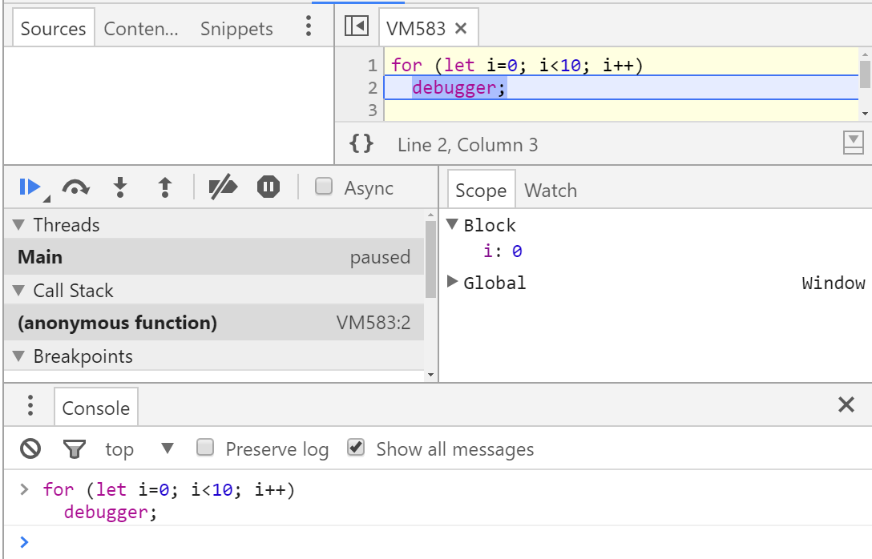
Invoking the JS Debugger
for (let i=0; i<10; i++)
debugger;

Slide 41
Alert / Confirm / Prompt Popups
In the browser we have alert(), confirm() and prompt()
alert("Greetings from JS");
if (confirm("Are you sure?")
document.write("Confirmed");
else
document.write("Canceled");
let name = prompt("Your name:");
alert(`Hello, ${name}`);

Slide 42
Summary
DHTML – HTML + CSS + JavaScript
JavaScript – dynamic (scripting) language
Variables have no type, values have type
Insert JS in HTML by <script src=…></script>
Numbers in JS are always floating-point (no integers)
JS uses automatic type conversion: "3" * true → 3
var gives "function scope", let gives "block scope"

Slide 43

Questions?

